Slide 1


Spreadsheet Sales Data Analysis Project Using Python
Presented by:
Bhavya Patteeswaran
Sharmila Dura
Prasanna
Taiyelolu Gabriel-Olufemi
Date: 14/Dec/2023

Slide 2
Agenda
Introduction to Spreadsheet Analysis
Project Planning
Aim of the Project (MOSCOW)
Requirement of Project
Extension/ Detailed Analysis of Project
Project Coding
Project Outcomes
Issues faced and resolved
Recommendation
Conclusions
Supporting Documents
Q&A Section

Slide 3
Introduction to Spreadsheet Analysis Project Objective
The objective of the spreadsheet data analysis project is to use a Python program to do basic data analysis on the given spreadsheet.
To plan and prioritise the requirements of the project, we have used the technique called MoSCoW method. M stands for the must, S stands for the should, C for the could, and W for the won’t, are the four categories used to prioritise the requirements.
The primary focus is on extracting relevant information from the spreadsheet, processing it, and presenting the essential insights. The project will initially cover these three required tasks, with the opportunity to extend the project and enhance the functionality.

Slide 4
Project Planning
Using the Python program, fetch the data of each monthly sales and expenditures and calculate the total, highest, lowest and percentage changes of the data.
Using Pandas, create the data frame and manipulate the data to find detailed analysis on calculating the net profit, net profit percentage, highest and lowest of net profit%, average and statistics of the data.
Using the Matplotlib & Numpy, create the graphical visualization to represent the sales and expenditure over months and net profit % over months in the charts.
Store the new data frame into an Excel file and save the visuals in .png format for easy sharing of data analysis and future reference.

Slide 5
Aim of the Project (MoSCoW)
Must
Read the data from the spreadsheet.
Collect all the sales from each month into a single list.
Output the total sales across all months.
Should
Collect the percentage changes of each month and highest and lowest sales.
Output the total expenditures across all months and find the highest and lowest.
Calculate the net profit and net profit % and find the highest and lowest profit in the year.
Calculate the statistics of sales and expenditures.
Could
User Interactions
Error Handling
Graphical Visualization
Wont
Merge two or more spreadsheets and output of visuals in the generated excel file.

Slide 6
Requirement of Project
1. Read the data from the spreadsheet.
- Developed a Python script to read data from the specified spreadsheet file.
2. Collect all the sales from each month into a single list.
- Aggregated sales data from each month into a comprehensive list.
3. Output the total sales across all months.
- Calculated and output the total sales across all months. - Display the result in a clear and understandable format.

Slide 7
Extension/ Detailed Analysis of Project
4. Calculate the monthly changes in sales as a percentage and display the summary. 5. Calculate the total expenditure across all months.
6. Calculate the detailed metrics such as - identify months with the highest and lowest sales. - identify months with the highest and lowest expenditure. - identify net profit by subtracting total expenditures from total sales for each month and output the summary of the net profit for the entire year. - identify net profit percentage by using the net profit and sales values and the percentage is formatted to two decimal places for better readability. - identify months with the highest and lowest net profit percentage to display the profit and loss. - identify the statistics and average of sales and expenditure by using describe method in pandas. - Presented the above metrics in a user-friendly format for better interpretation. 7. Graphical Visualization to represent the sales and expenditure over months in the charts. - Enhanced the script to include graphical visualization for both sales and expenditure by using bar graphs to represent monthly trends and Net profit % over months in the line & bar chart and the visuals are stored in the .png file to reuse in the reports. 8. User Interactions for data selections - Allowed the users to input parameters or choose specific analyses to perform while running the program. 9. Implement the error handling technique. 10. Store the new data frame output into an Excel file for easy sharing of data analysis and future reference.

Slide 8
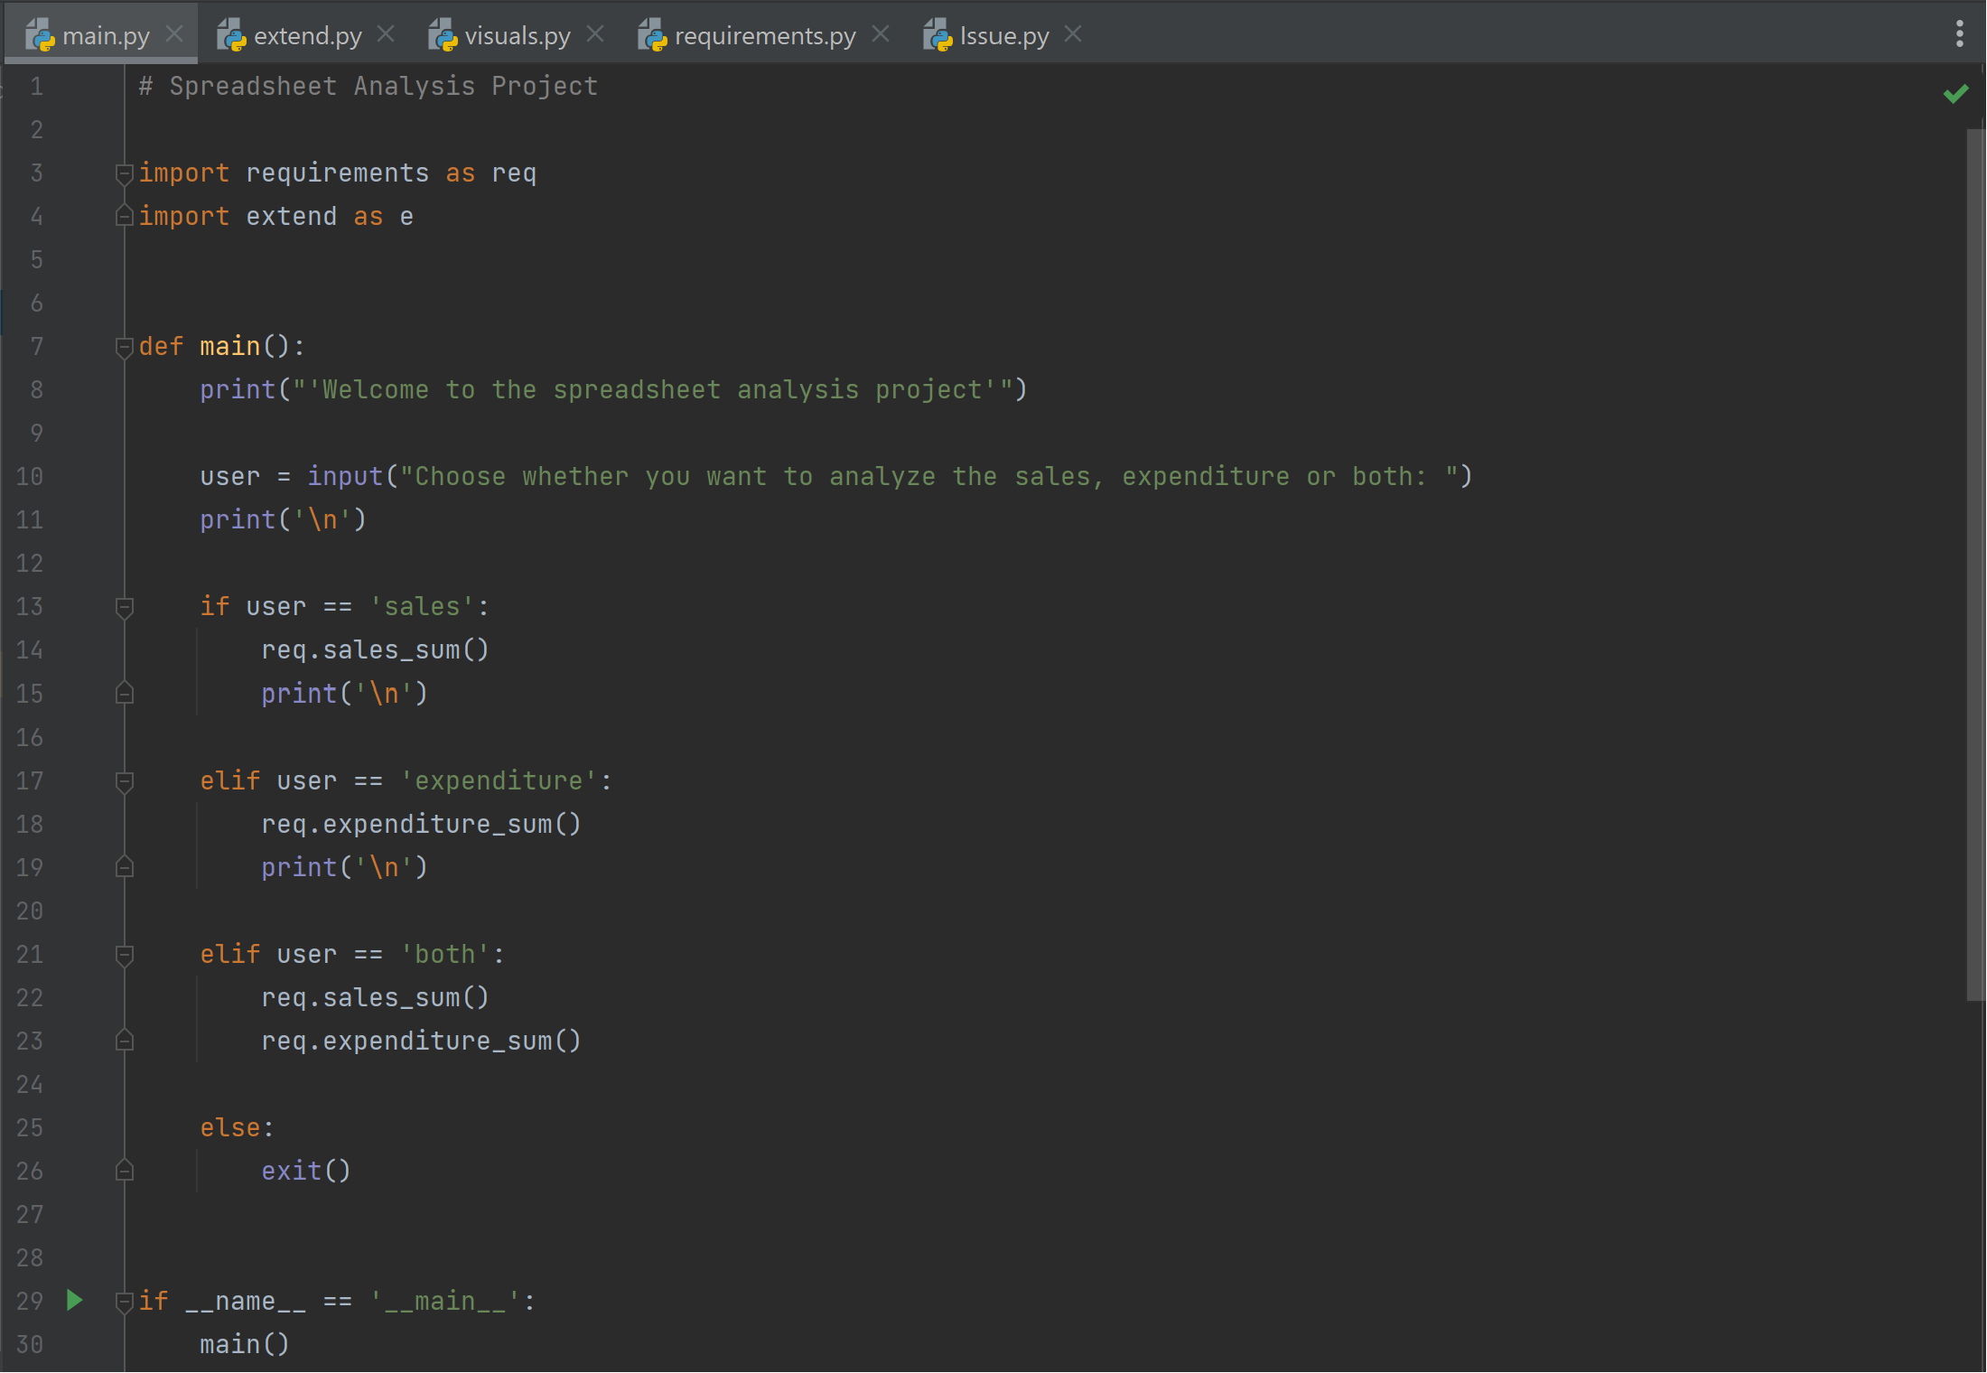
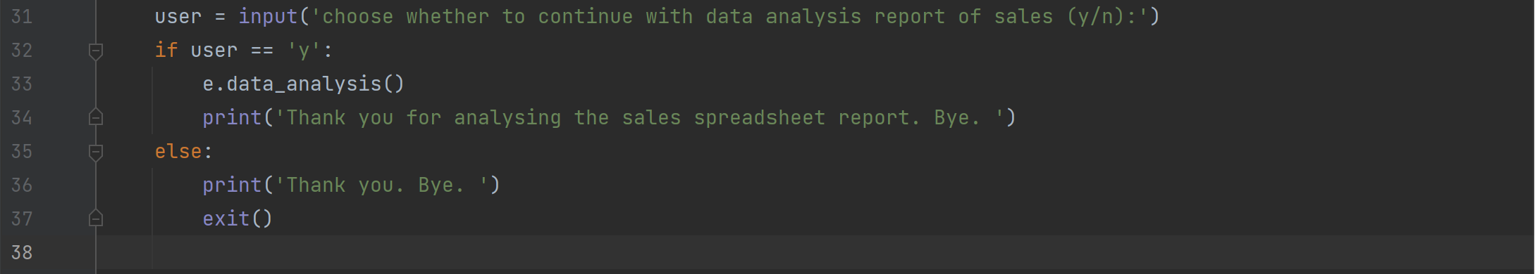
Project Coding
main.py file
User interaction for data selection that allows users to choose whether they want to analyze sales, expenditure, or both which provide options for users to select the specific analyses they are interested in.
To view the extend detail analysis, allow the users to choose y/n to proceed further on the analysis.

Slide 9
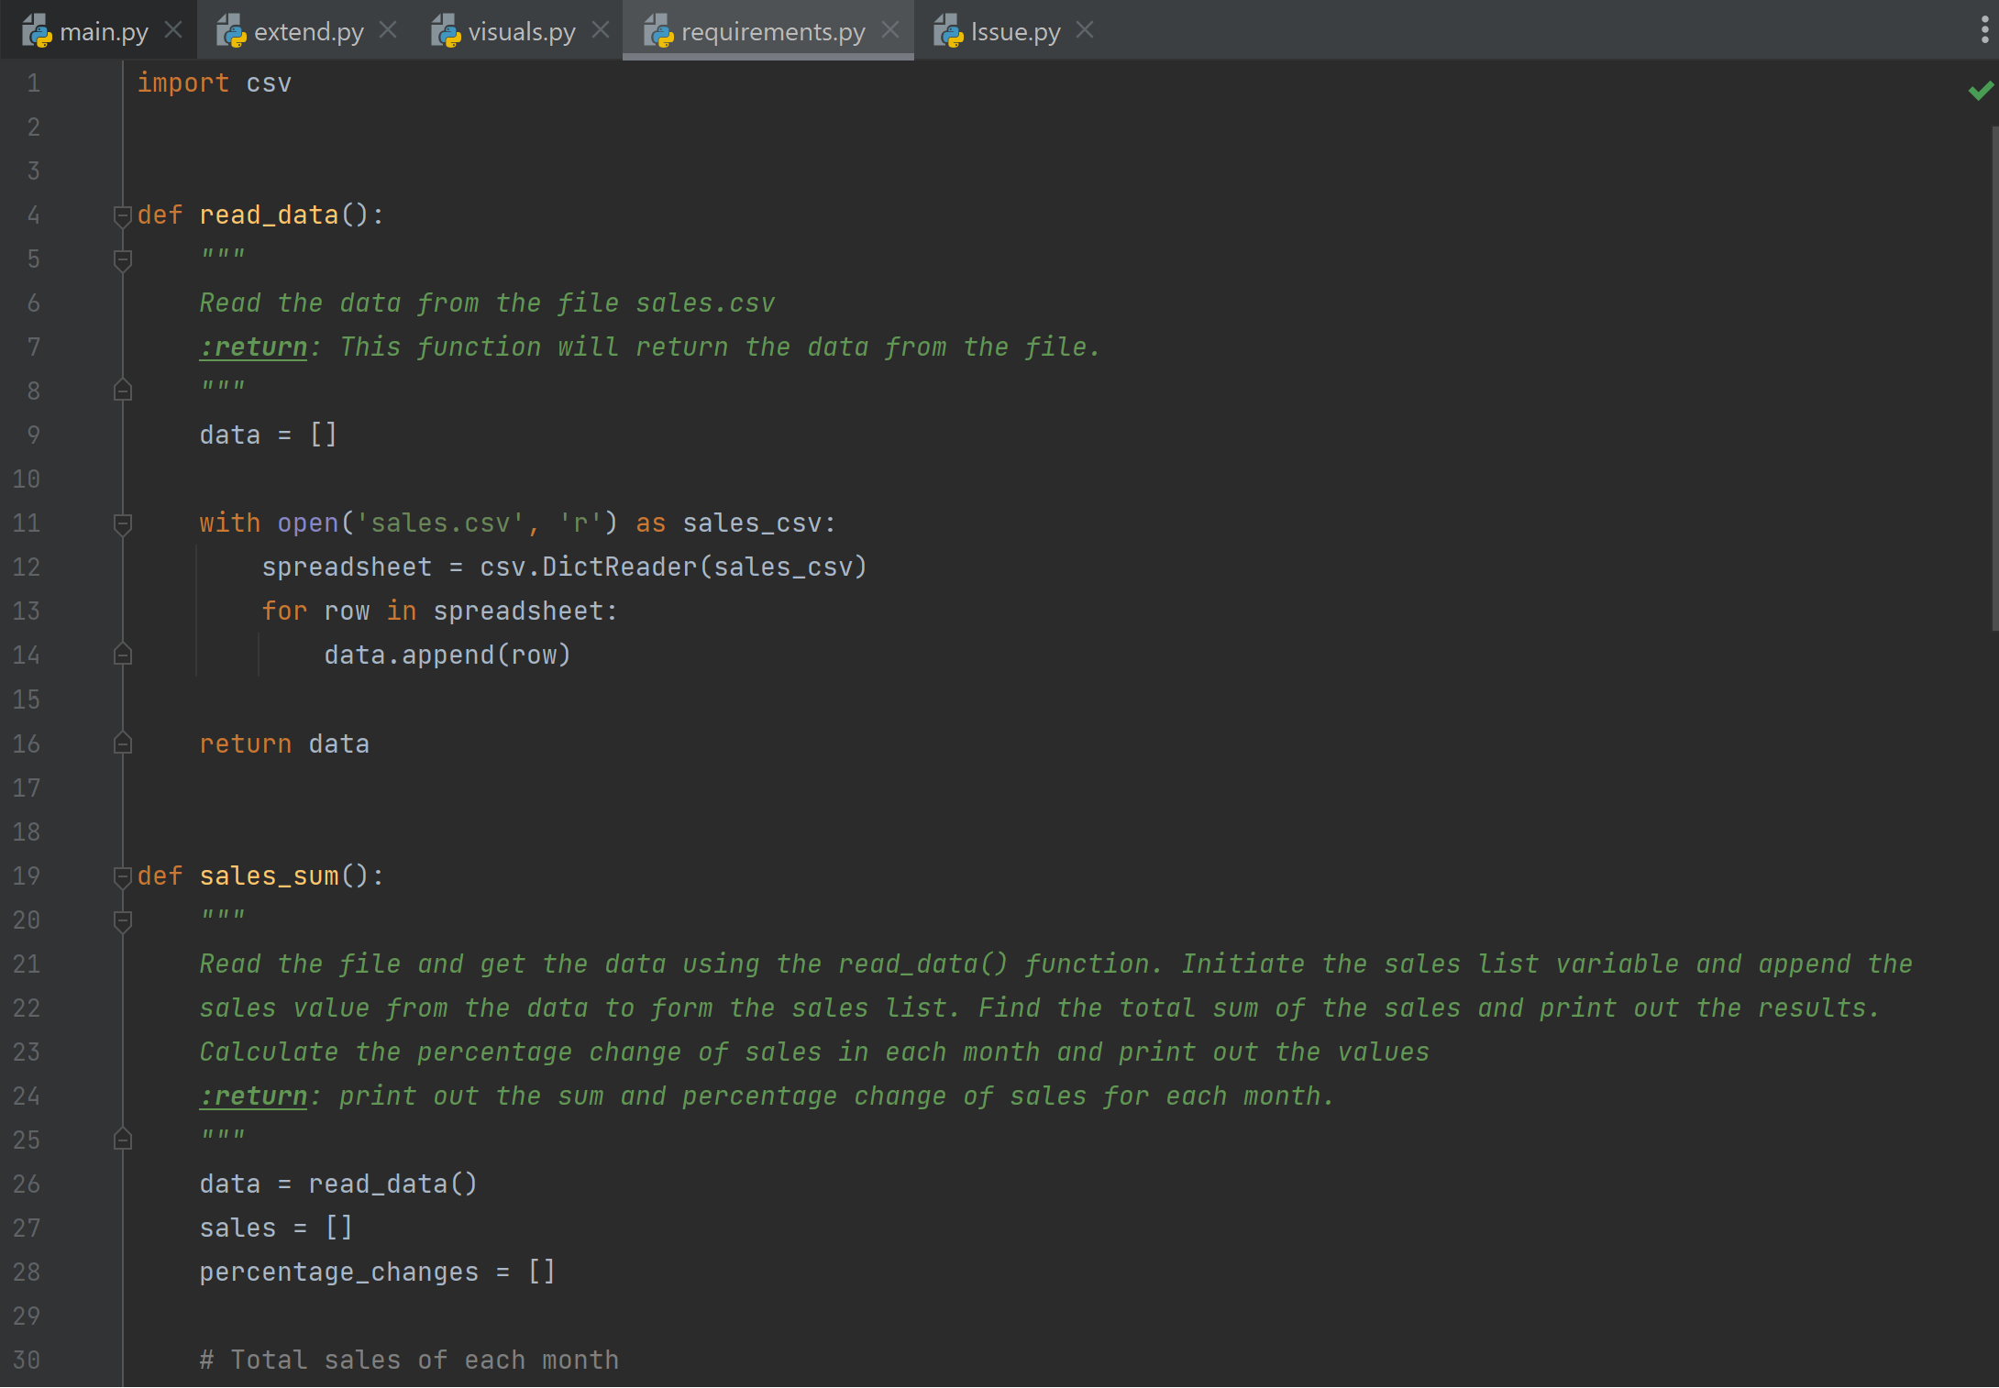
Project Coding
requirements.py file
read_data() function will read the data from the file sales.csv and return the entire rows in the list.
sales_sum() function will use the read_data() function to get the data from csv file and separate the sales value to append in sales list.

Slide 10
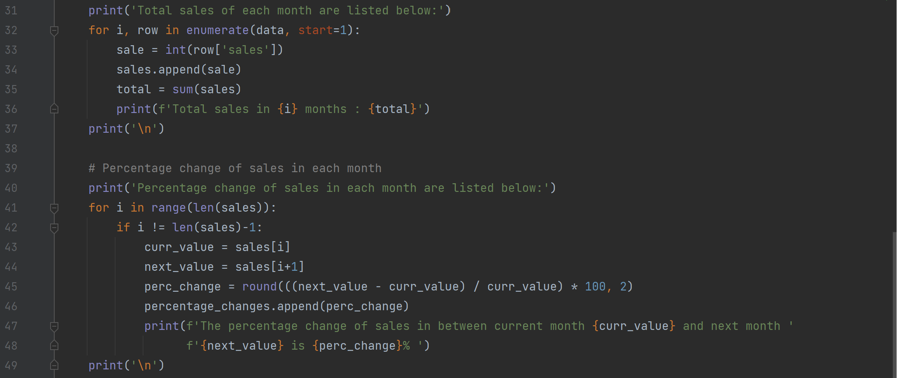
Project Coding
requirements.py file
The total sales are calculated using the sales list and print out the output for each month.
The percentage change of sales in each month are calculated using the sales list and print out the output for each consecutive month.

Slide 11
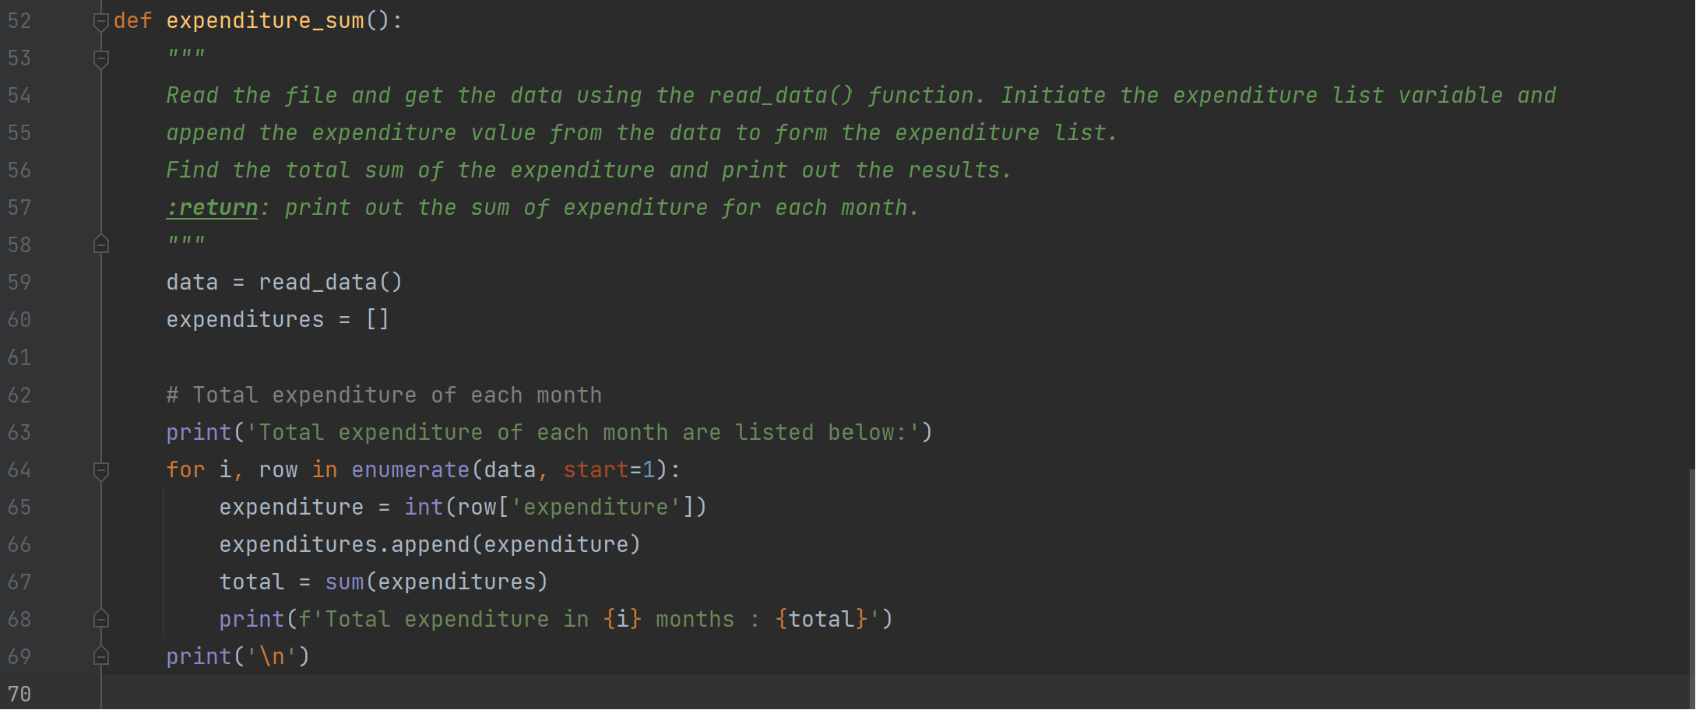
Project Coding
requirements.py file
expenditure_sum() function will use the read_data() function to get the data from csv file and separate the expenditure value to append in expenditures list.
The total expenditure are calculated using the expenditures list and print out the output for each month.

Slide 12
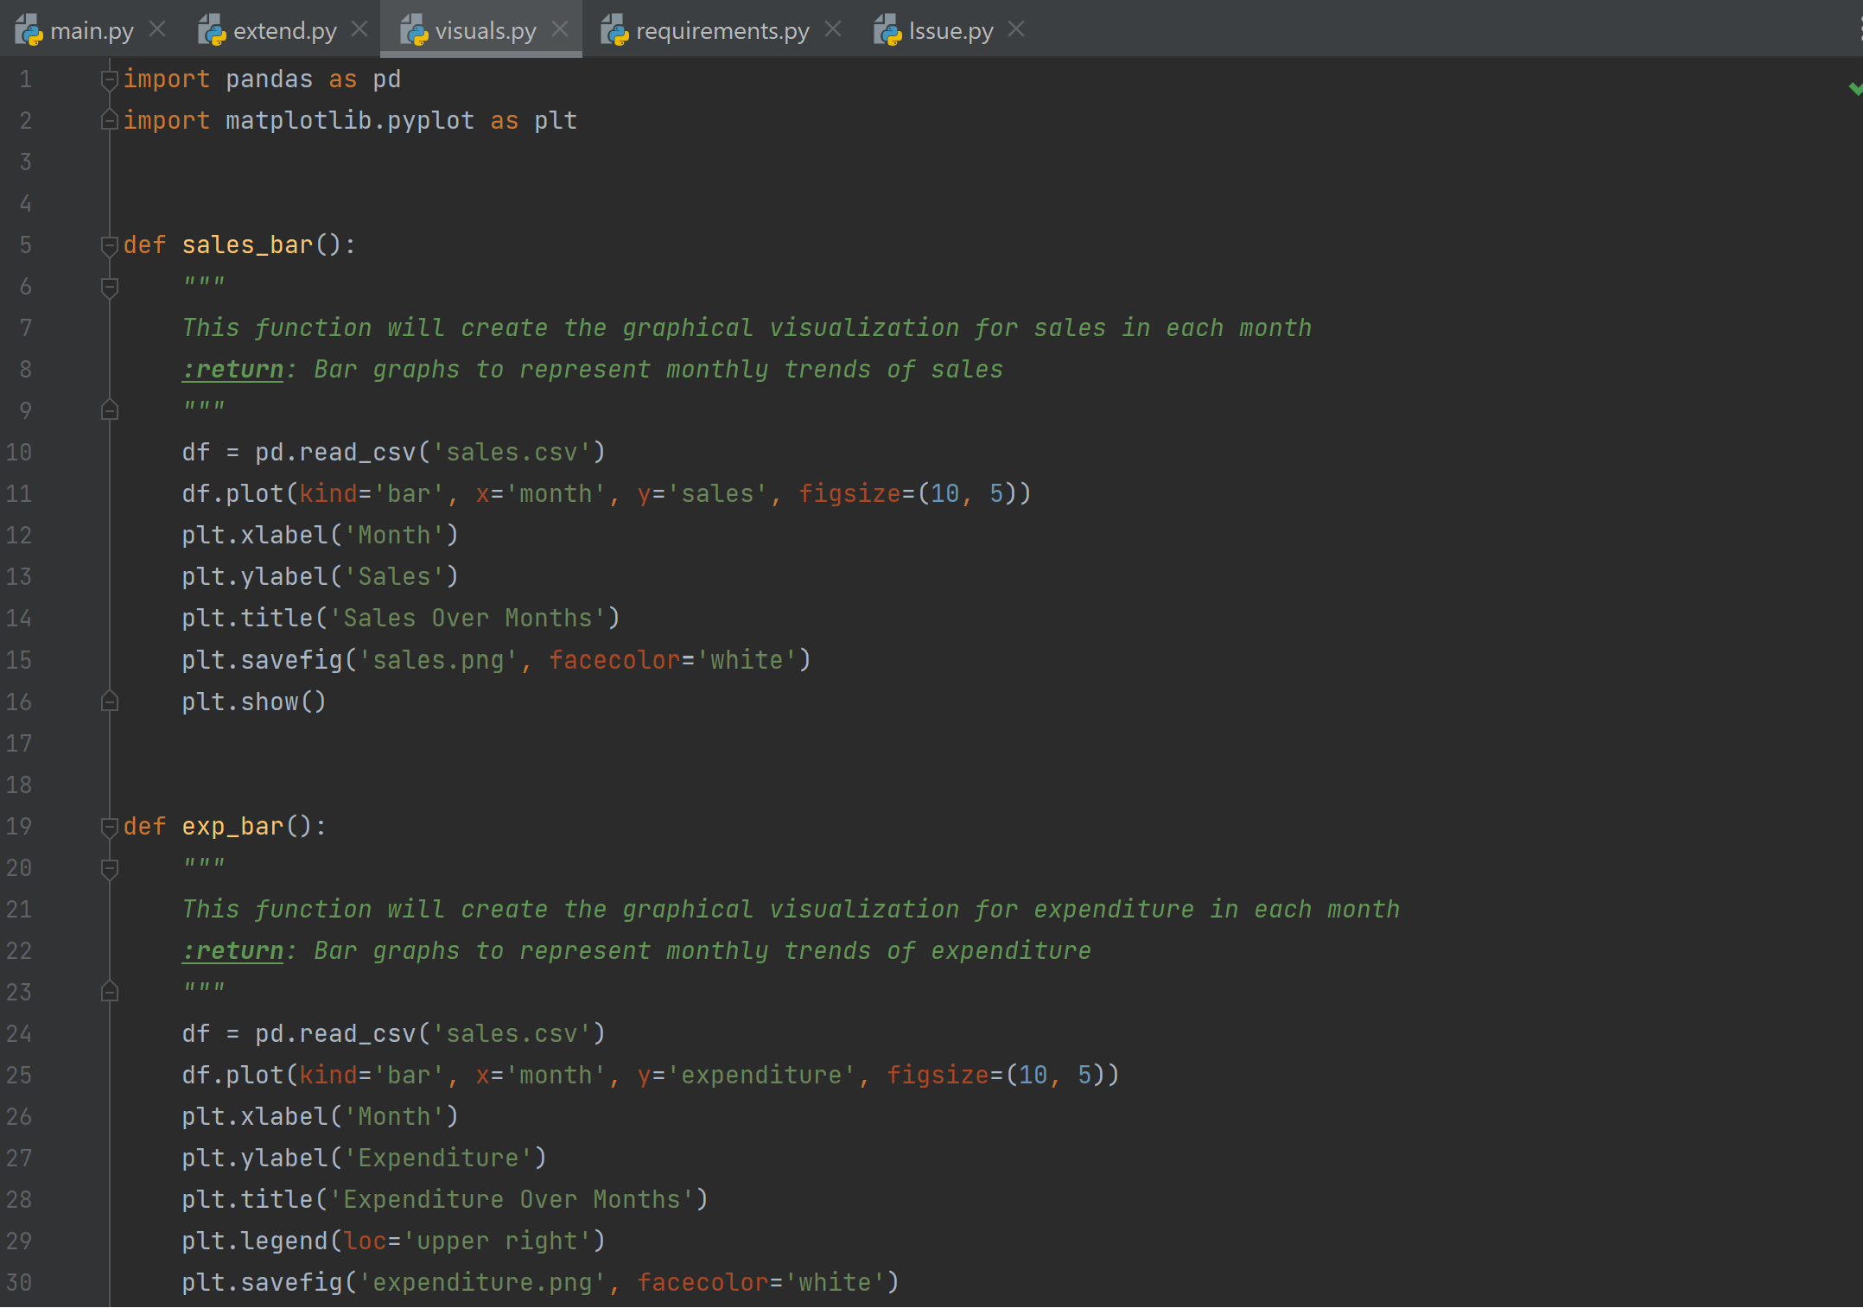
Project Coding
visuals.py file
sales_bar() function will create the graphical visualization for the sales in each month using the bar chart and the figure is displayed and saved into ‘sales.png’ file to reuse in the report.
exp_bar() function will create the graphical visualization to represent the monthly trends of expenditure using the bar chart and the figure is displayed and saved into ‘expenditure.png’ file to reuse in the report.

Slide 13
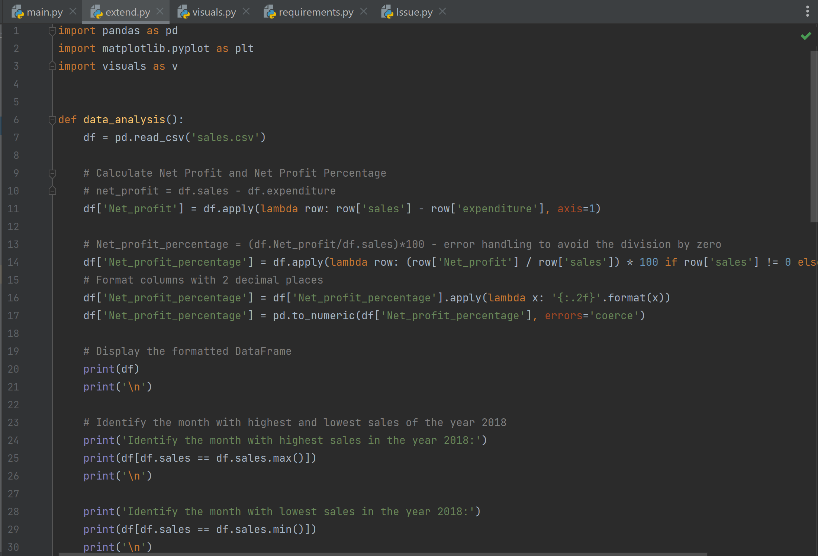
Project Coding
extend.py file – In data_analysis() function created,
Using the pandas, the ‘sales.csv’ file is converted to data frame.
Calculate the net profit:
net_profit = df.sales - df.expenditure
Calculate the net profit %:
Net_profit_percentage = (df.Net_profit/df.sales)*100 - error handling to avoid the division by zero
- the percentage is formatted to two decimal places for better readability.
- Print the data frame
Identify the month with highest and lowest sales of the year 2018.

Slide 14
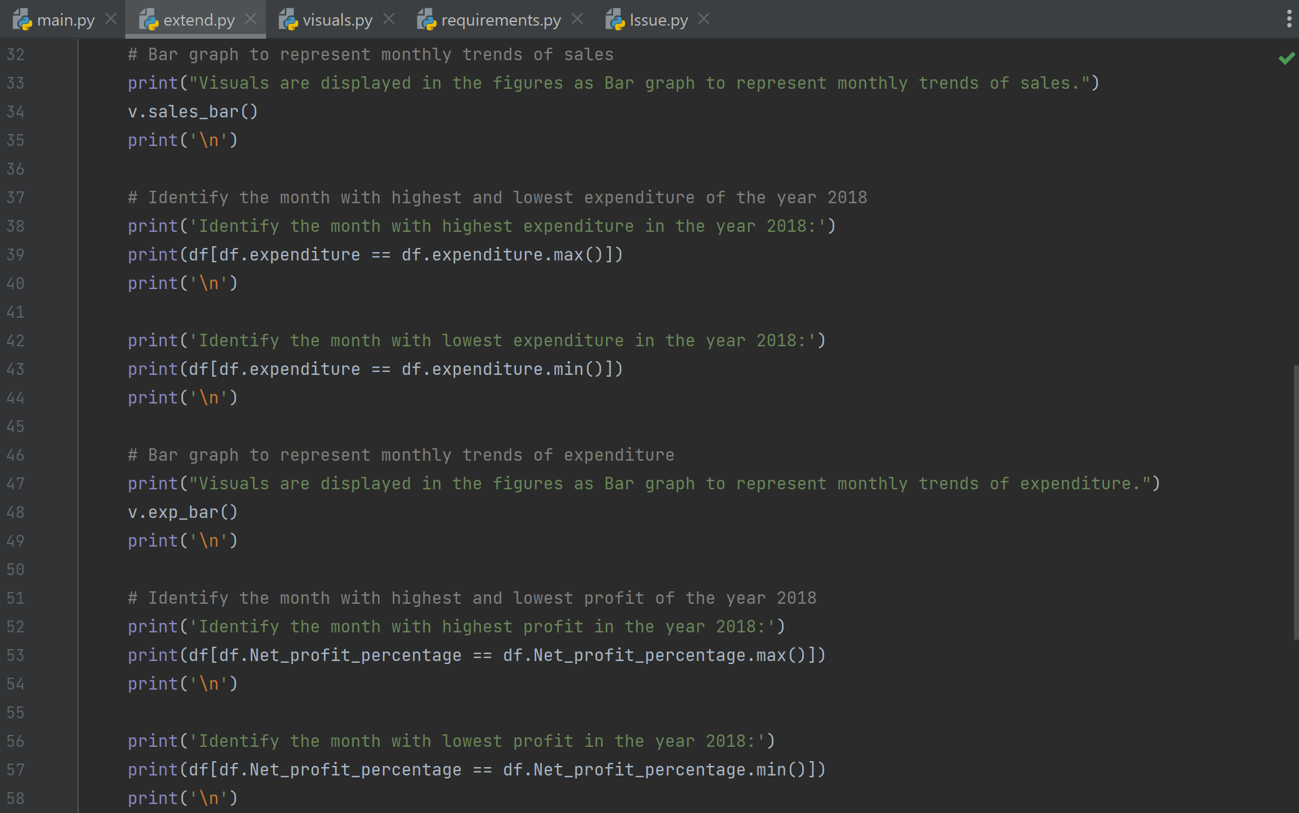
Project Coding
extend.py file – In data_analysis() function created,
Display the bar graph to represent the monthly trends of sales and identify the highest and lowest sales in the chart.
Identify the month with highest and lowest expenditure of the year 2018.
Display the bar graph to represent the monthly trends of expenditure and identify the highest and lowest expenditure in the chart.
Identify the month with highest and lowest net profit percentage.

Slide 15
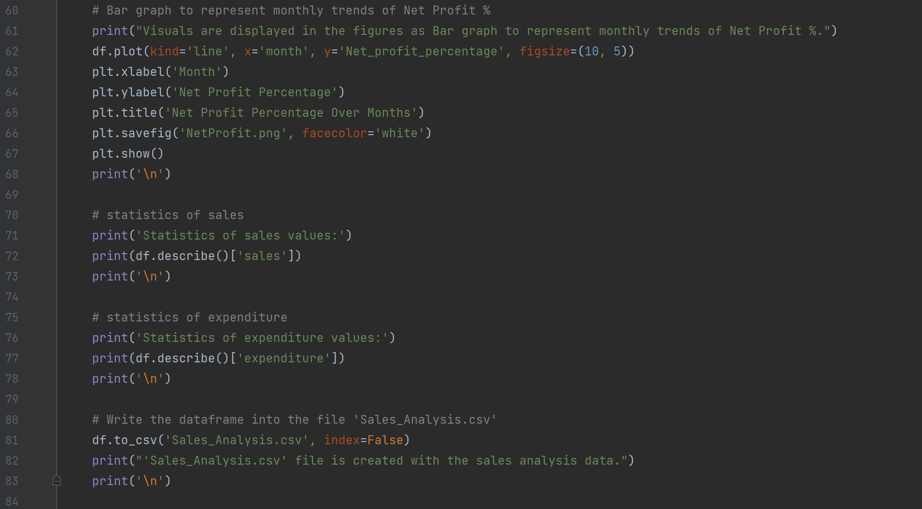
Project Coding
extend.py file – In data_analysis() function created,
Display the line & bar charts to represent the monthly trends of net profit in % and identify the highest and lowest net profit% in the chart.
Display the statistics of sales and expenditure using describe method in the pandas
Write the data frame into an Excel file ‘Sales_Analysis.csv’ and remove the unwanted index in the excel sheet by using index as False.
Save all the visuals in the .png file for the future reference.

Slide 16
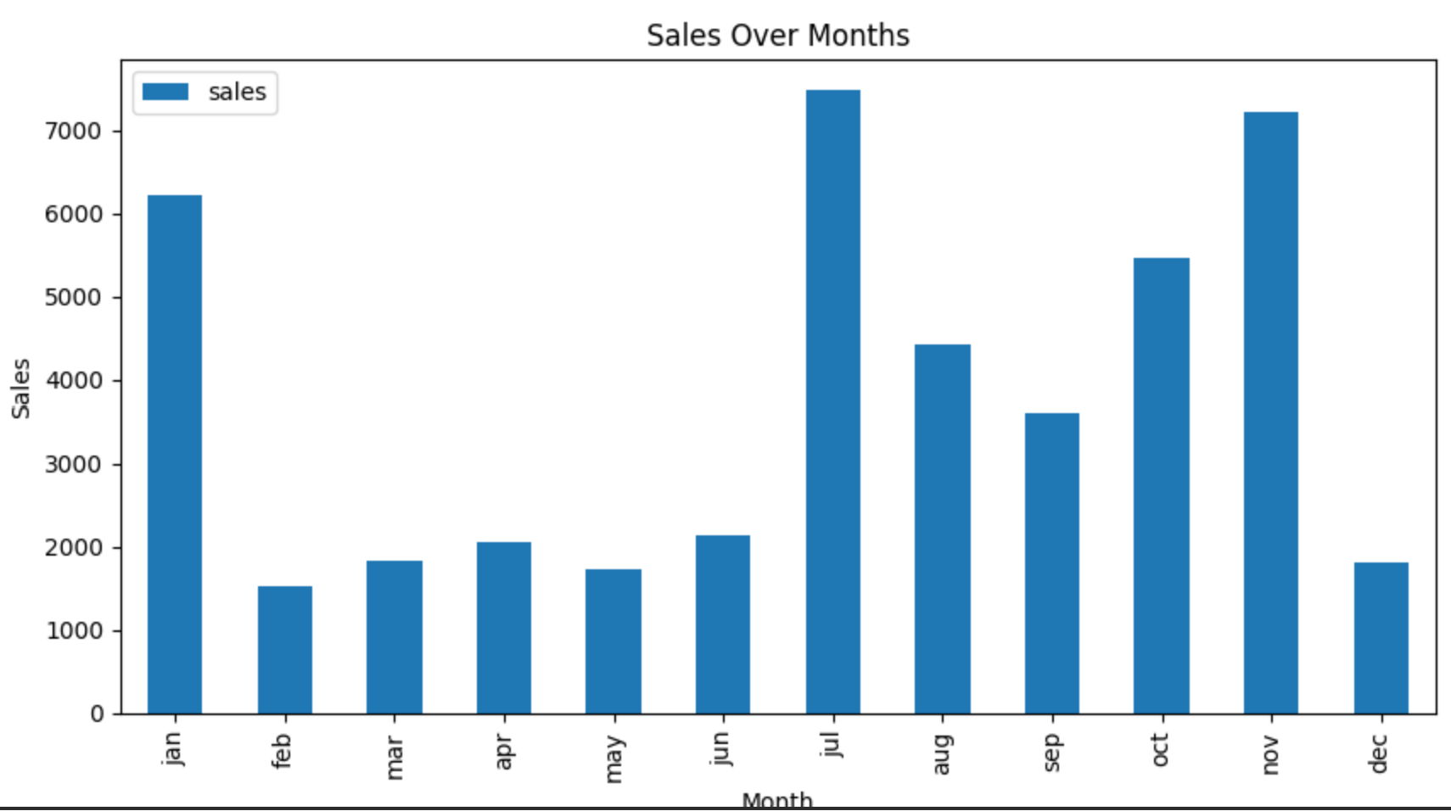
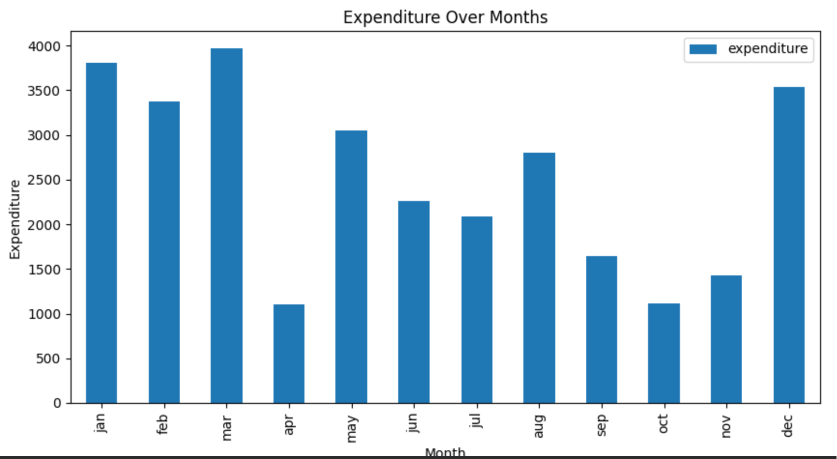
Project Outcomes
Sales over month
Highest month sales in July: 7479
Lowest month sales in February: 1521
Total Sales: 45542
Expenditure over month
Highest month expenditure in March: 3965
Lowest month expenditure in April: 1098
Total expenditures: 30159

Slide 17
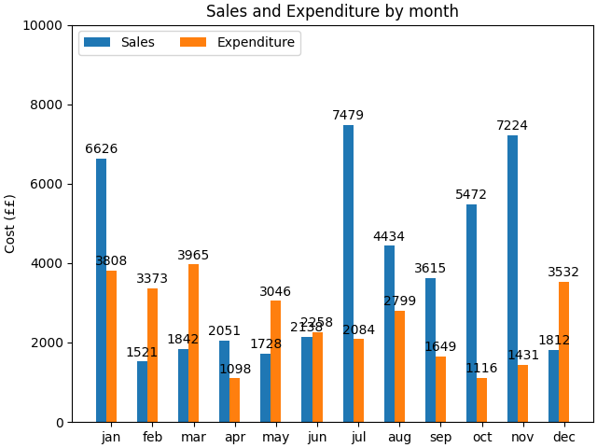
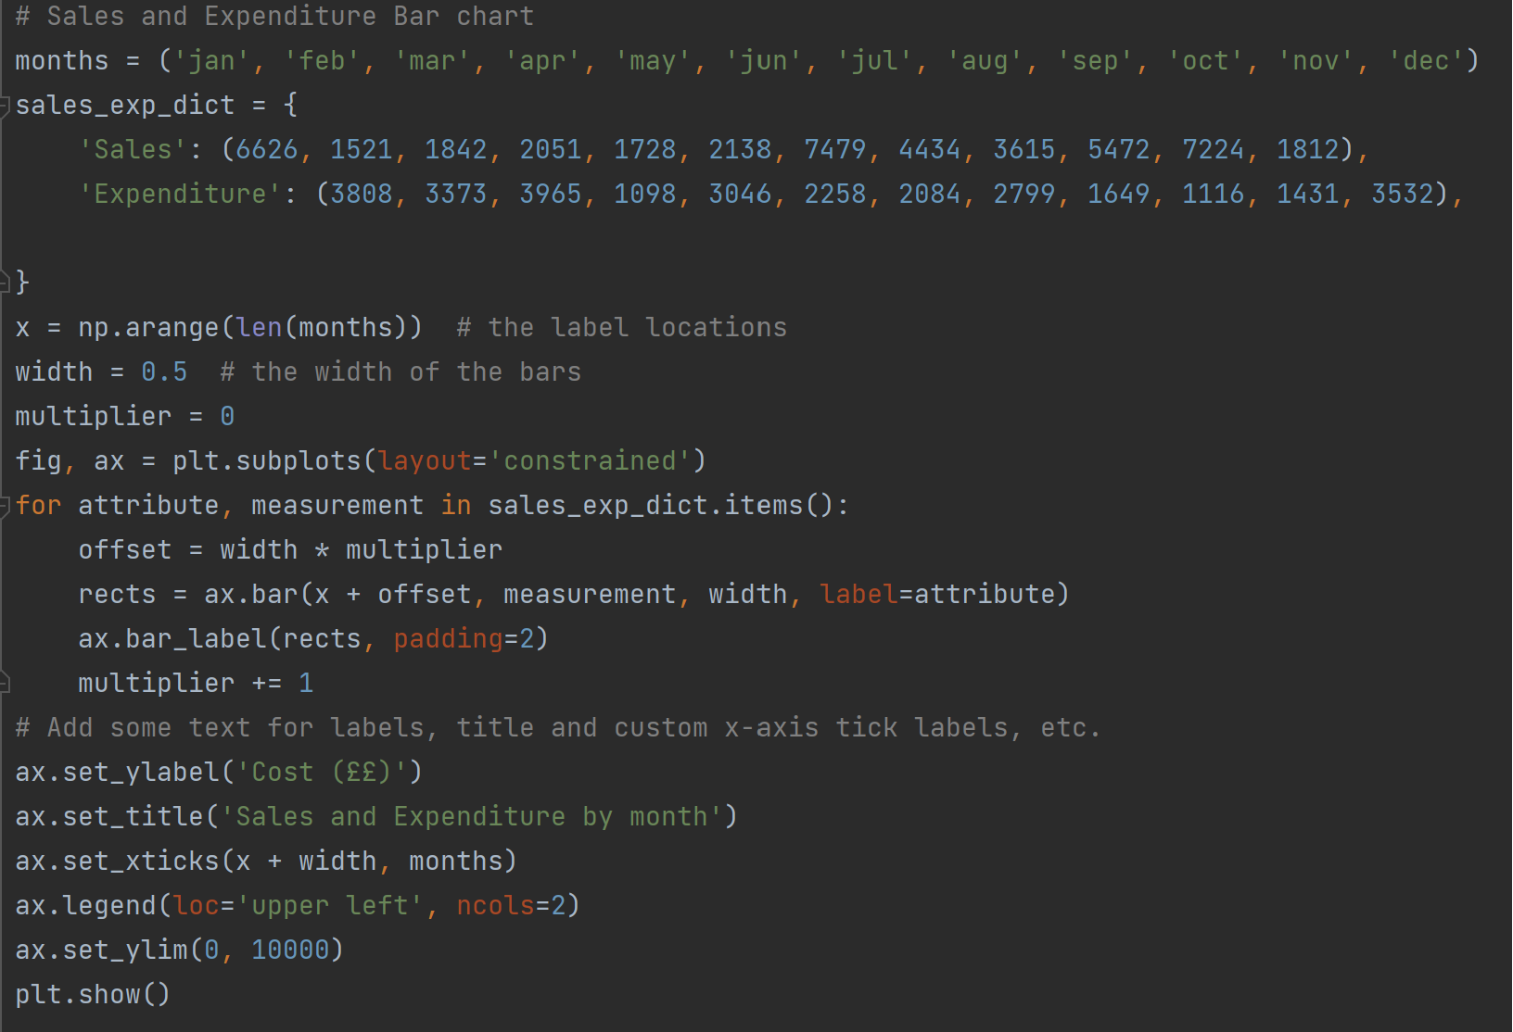
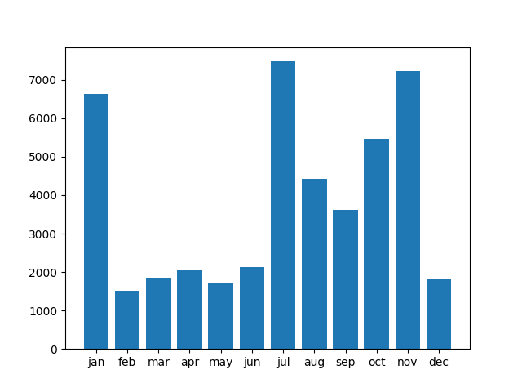
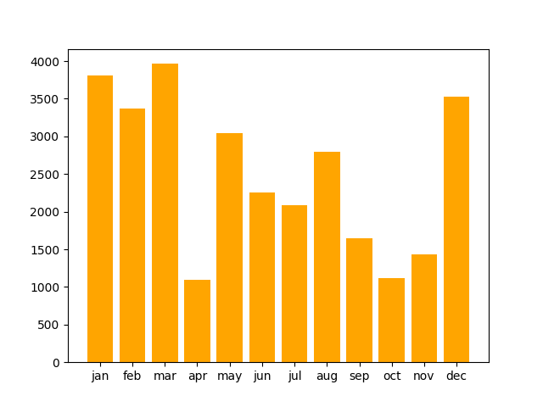
Project Outcomes
Sales & Expenditure Bar chart

Slide 18
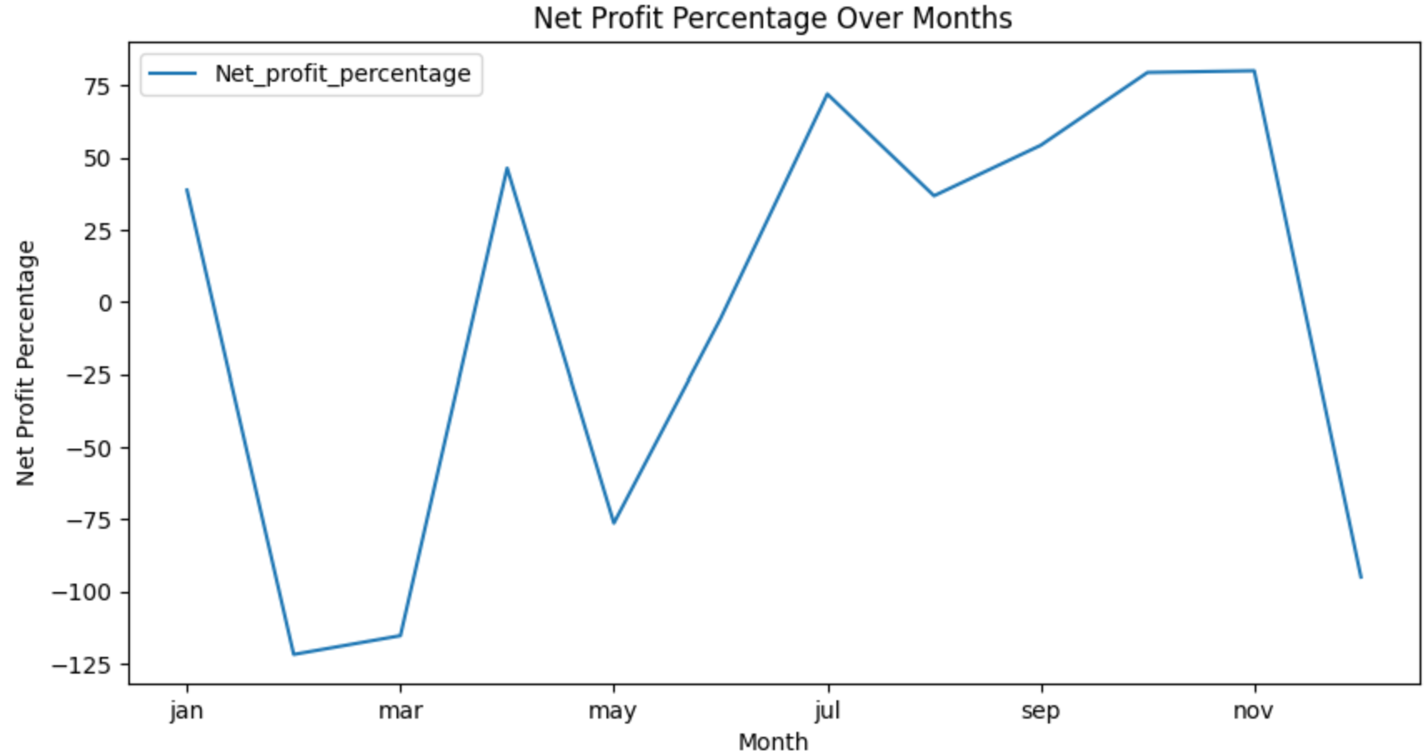
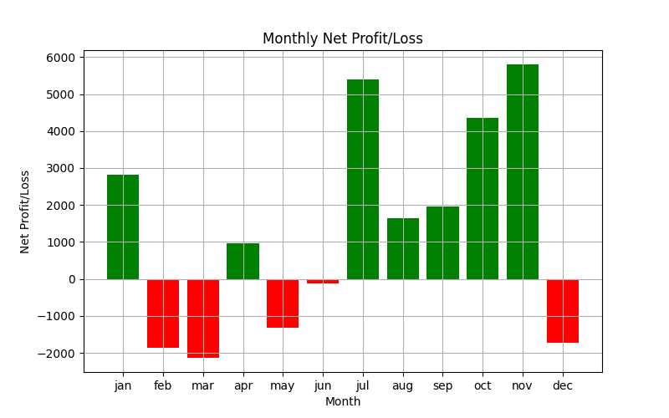
Project Outcomes
Net Profit% over month:
Highest month Net Profit% in November: 80.19%
The highest net profit percentage was observed in November, reaching 80.19%. This could indicate a particularly successful or profitable period for the business during that month.
Lowest month Sales in March: -115.26%
The analysis mentions the lowest sales, which is -115.26%, in March. The negative value suggests that the business experienced a loss rather than a profit in that specific month. It's important to investigate why the sales percentage is negative in March and identify any contributing factors.

Slide 19
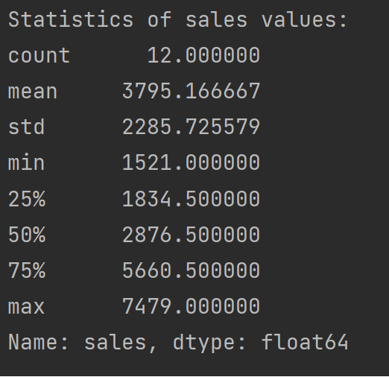
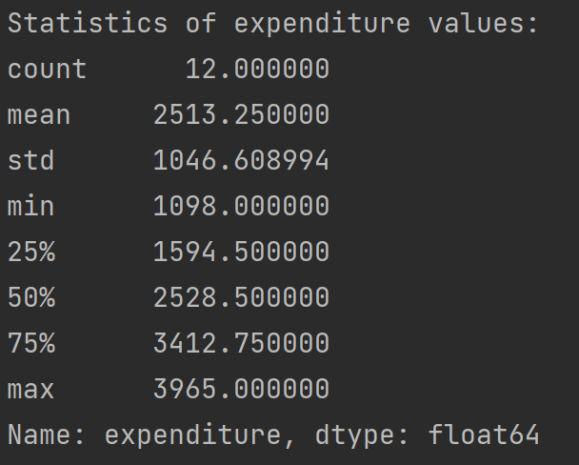
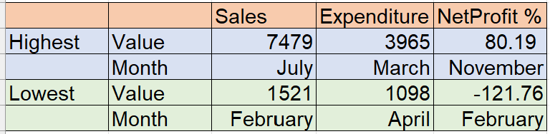
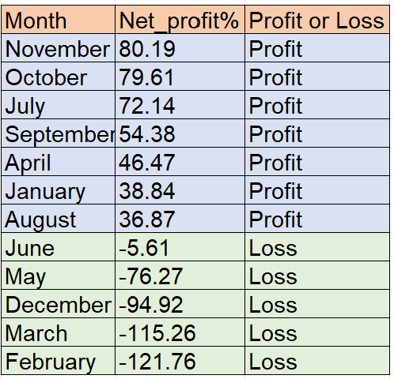
Project Outcomes
Statistics of the Sales and Expenditure:

Slide 20
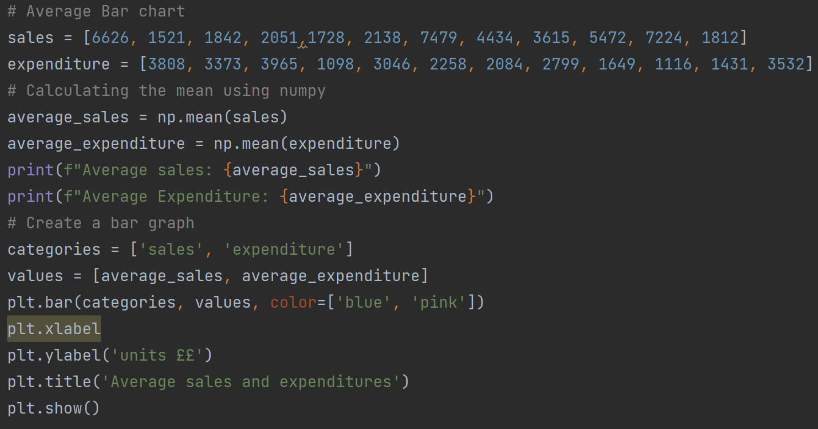
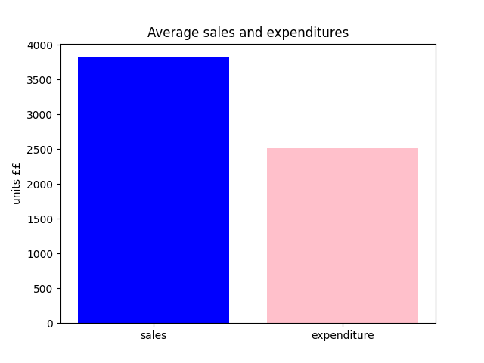
Project Outcomes
Average Sales and Expenditure
Average sales: 3828.5
Average Expenditure: 2513.25

Slide 21
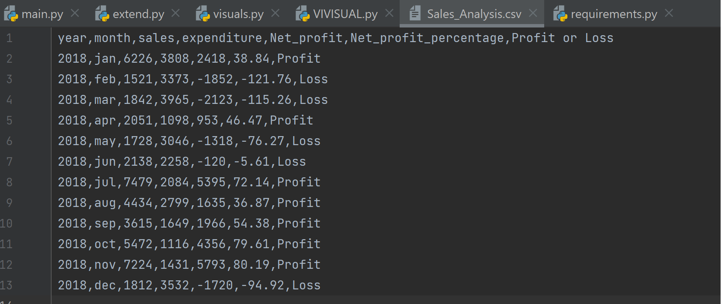
Project Outcomes
The outcome of the data frame is stored in an Excel file ‘Sales_Analysis.csv’

Slide 22
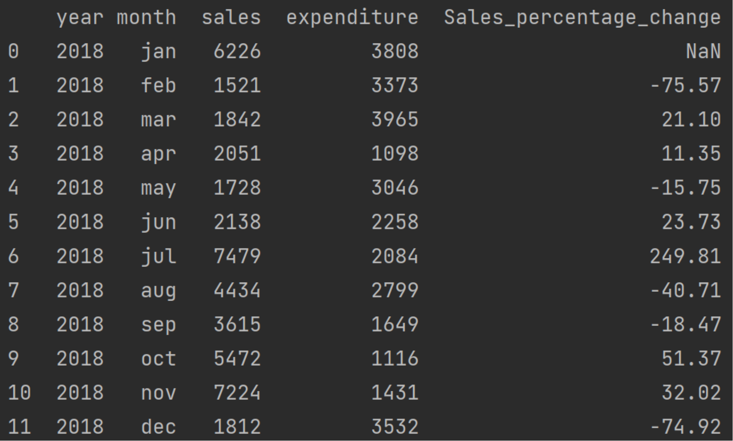
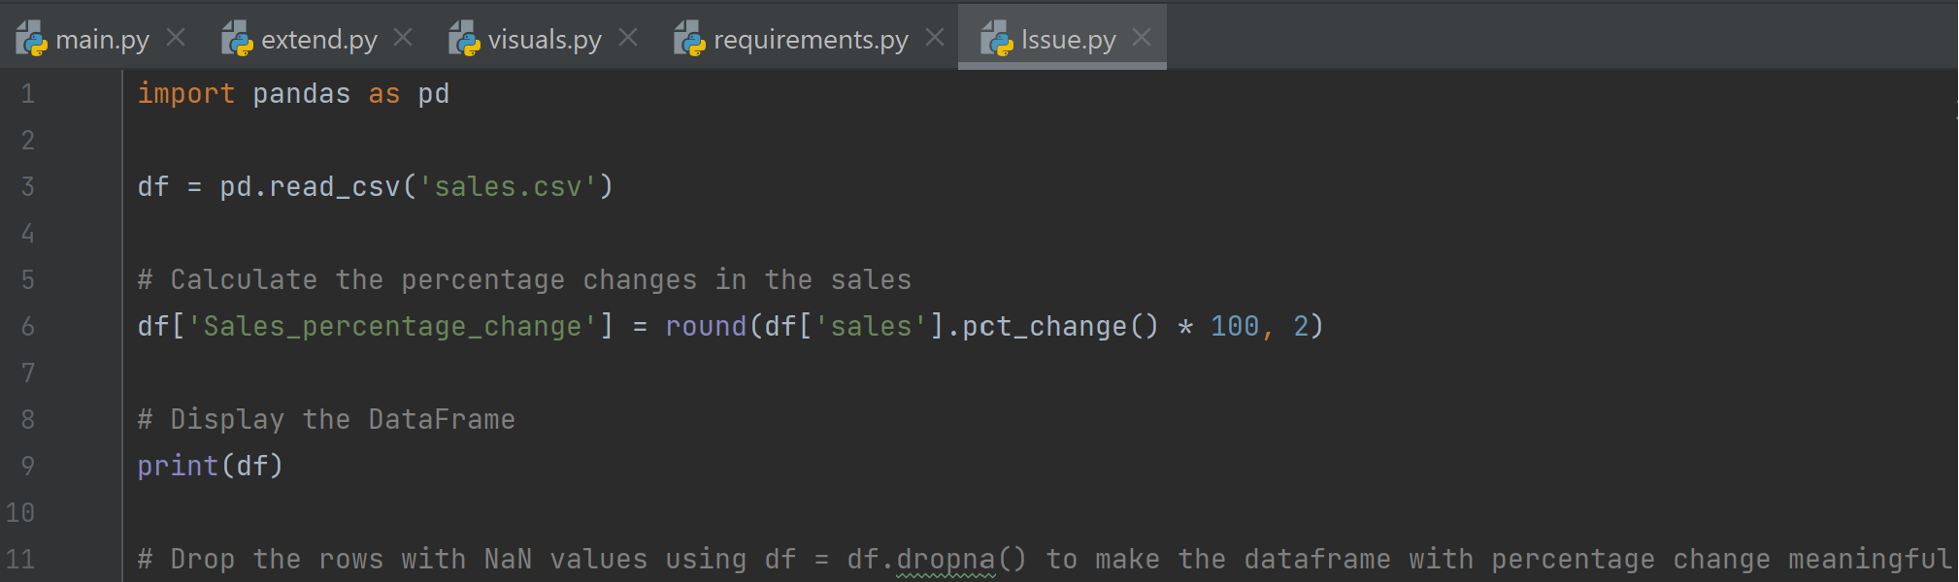
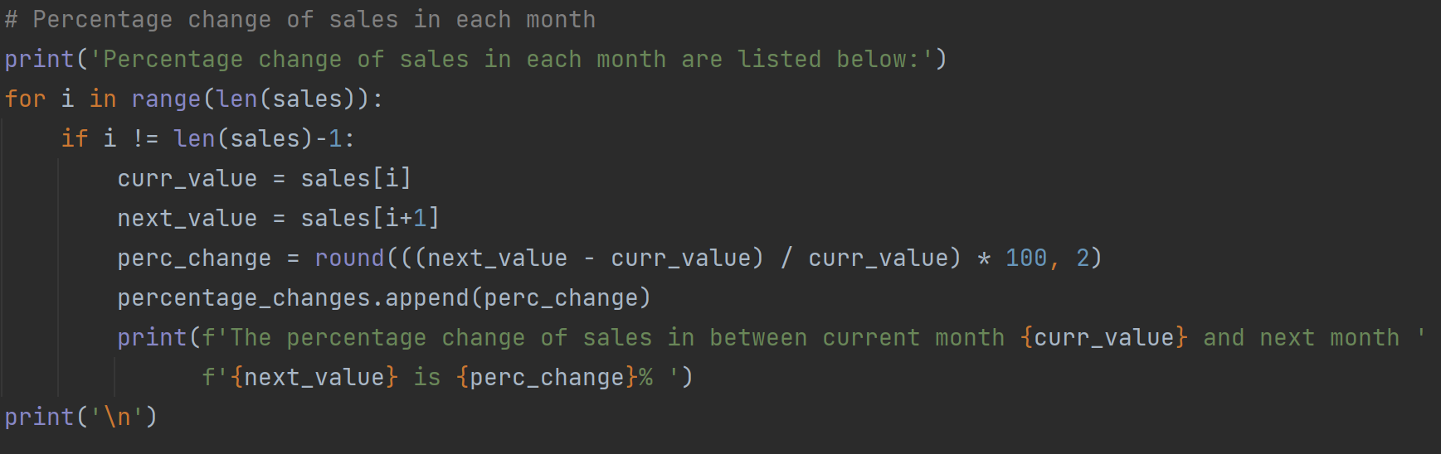
Issues faced and resolved
To Calculate the percentage changes in sales, using Pandas will create the NaN values.
To avoid the drop of rows, used another approach using the sales list generated from the requirement task and analyzed the percentage changes in sales.

Slide 23
Recommendation
Potential Additional Analysis:
Investigate the factors that contributed to the exceptionally high net profit percentage in November. Was there a specific event, promotion, or business strategy that led to this outcome?
Explore the reasons behind the negative sales percentage in March. Identify any challenges or issues that may have impacted sales during that period.
Consider comparing these findings with external factors, such as industry trends, economic conditions, or seasonal variations, to provide a broader context for the analysis.
November Success Analysis:
Investigate the specific strategies, events, or operational efficiencies that contributed to the exceptionally high net profit percentage in November.
Identify whether similar strategies can be applied to other months to enhance overall profitability.
February Loss Analysis:
Examine the reasons behind the negative net profit percentage in February. Was it due to unexpected costs, low sales, or other factors?
Implement measures to mitigate similar issues in the future and improve overall financial performance.

Slide 24
Conclusions
In summary, the provided output highlights specific months with notable net profit percentages, both high and low in November and March. This is valuable for understanding how the company's profitability fluctuates across different months.
Further analysis and investigation are needed to understand the underlying factors contributing to these outcomes and to provide actionable insights for business decision-making.

Slide 25
Supporting Documents
In the zip folder, we can find the Python Files, Outcome visuals and output Excel file.

Slide 26

By
Team Nine
You can contact me in LinkedIn Profile or in email.
Notes:
Thank you for listening.
If you have any questions, I am happy to answer them.
Thank you!!!

